Slide 1
moviX
Major project presentation

Slide 2
PROJECT MEMBERS :-
Harsh Kain (2200290140065)
Akarsh Shekhar Singh (2200290140017)
Deepanshi Sharma(2200290140052)
PROJECT SUPERVISOR :-
M/S SHALIKA ARORA(asst. Professor)

Slide 3
introduction
Our platform designed to showcase the world of cinema. Featuring an extensive movie database, interactive user interface, and personalized recommendations, our project aims to provide an immersive experience for movie enthusiasts. Using modern web technologies such as React, Tailwind Css, Appwrite Redux, we have created a user-friendly website that allows users to explore, discover, and engage with their favorite films. From browsing movie listings to connecting with fellow cinephiles, our project offers a comprehensive solution.

Slide 4
Technologies / Software Requirements
Programming Language:React.js ,Redux, Appwrite
Database used: Appwrite
SOFTWARE REQUIREMENT
Text Editor : Visual Studio Code ,Sublime Text
Web Browser : Google Chrome , Mozilla Firefox
Node.js and npm (Node Package Manager)

Slide 5
Hardware requirement / Hardware Used
Laptop Mobile or PC
Windows 7 or higher
I3 processor system or higher
4 GB RAM or higher
100 GB ROM or higher

Slide 6
Modules Description
User Authentication and Authorization:
This module handles user registration, login, and authentication processes.
Users can create accounts, log in securely, and access personalized features.
Create React components for login, registration, and user profile.
Use React Router to manage navigation between different pages.

Slide 7
User Interface
Homepage: The homepage should feature a visually appealing design that showcases current and upcoming movies.
Navigation: A clear and intuitive navigation menu is essential for users to easily browse different sections of the website, such as movies, theaters, showtimes, and user account settings.
Movie Listings: The movie listings page should display a grid or list of movies with relevant information such as movie posters, titles, release dates, ratings, and brief descriptions. Users should be able to filter and sort movies based on different criteria like genre, release date, and rating.

Slide 8
Movie Details: Clicking on a movie should lead to a detailed page with more information about the movie
Search Functionality: A search bar allows users to quickly find movies based on keywords, titles, genres, or actors.
Responsive Design: The UI should be responsive and optimized for various devices, including desktops, laptops, tablets, and smartphones, to ensure a seamless user experience across different screen sizes.

Slide 9
Search Functionality:
A search bar allows users to quickly find movies based on keywords, titles, genres, or actors.
Responsive Design:
The UI should be responsive and optimized for various devices, including desktops, laptops, tablets, and smartphones, to ensure a seamless user experience across different screen sizes.

Slide 10
OUTPUTS
User Interface Screenshots:
Screenshots of the website's user interface, showcasing various pages, features, and functionalities.
Includes screenshots of the homepage, movie listings, movie details page, user profile, search results, etc.
Demo Videos:
Recorded demonstrations of key features and workflows on the website, providing a visual walkthrough for stakeholders and users.
Demonstrates processes such as user registration, movie browsing, search functionality, writing reviews, etc.

Slide 11
Reports
User Registration and Login Report:
This report includes statistics on user registrations, login attempts, and account activations.
It provides insights into user demographics, such as age groups, geographical locations, and registration trends over time.
Movie Database Report:
This report presents an overview of the movie database, including the total number of movies, genres, directors, actors, etc.
It highlights popular genres, top-rated movies, and trending titles based on user interactions and ratings.

Slide 12
Analytics Dashboard:
Interactive dashboard displaying real-time analytics and metrics related to website performance, user engagement, and content popularity.
Includes charts, graphs, and data visualizations for tracking key performance indicators and making data-driven decisions.
User Feedback and Testimonials:
Compilation of user feedback, testimonials, and reviews gathered through surveys, feedback forms, and user interviews.
Highlights positive feedback, constructive criticism, and suggestions for improvement from actual users of the website.

Slide 13
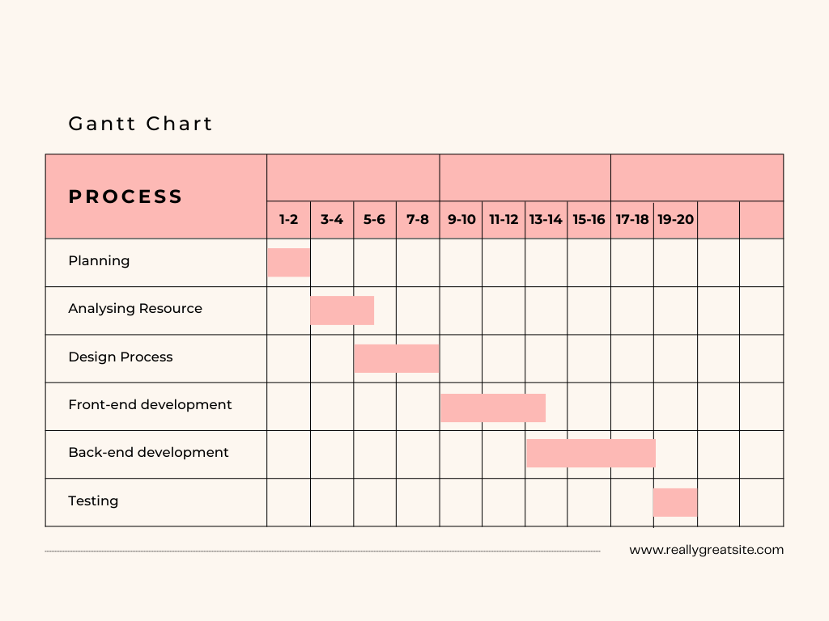

Slide 14
conclusion
The Movie Website College Project represents a successful endeavor in web development, offering a dynamic platform for movie enthusiasts. Through user-centric design and innovative features, the project provides an immersive experience for exploring and engaging with movies. Future enhancements will build upon this foundation to further refine the user experience and expand the website's capabilities. Overall, the project showcases the team's dedication and expertise in creating a valuable resource for cinema enthusiasts.

